Slide 1


KETHOLESHIIDA… DIETHERIEKO
Ketholeshiida … Dietherieko kezhakesu, Kijiipete Krothoko Fort Worth, Texas
©2006 TBBMI
Designed by Dr. John Fryman, Texas, USA • BibleBasically.org
Taught by Dr. Rick Griffith, Singapore Bible College
All files in many languages for free download at BibleStudyDownloads.org
www.biblebasically.com
©2006 TBBMI

Slide 2


Chapimiako nu vo Esther ketso
7
PELHOUKESHII
KEBVIIKEBOU
Thenu thepfu kerietho nie
P
Kephouma keriethou
Dieliekevi keriethou
Kikru keriethou
KEDIMIAKO
(1000 B.C.)
Kedukhri keriethou
DD
Dziidei/pfhesei
Tsiepfhe
(2000 B.C.)
ABRAHAM
Puo Kekie
AD
DK
P 7 Z J
KROTHO 3
L - S - B
I - I
J - E
12
KEDIEKECHII
7 = 4 + 3
JOSEF
THEMIA 4
Miadiemia
430
MOSA
(1500 B.C.)
Tuokepra
Z
S
ZEIKECII
Sinai
M - C - C
Kadesh Barnea
JISU
40
40
KD
5 Sermons
J
JOSHUA
Jericho/Ai
Kijii kezakewa
01
3
Notes:
//// Now it’s time to move on through THE BIBLE FILE from CREATION and 4 PEOPLE into the
//// 3 KINDS OF SOCIETY or social structure. Remember their order “A-R-C”…
//// …ANARCHY, ROYALTY, CAPTIVITY.

Slide 3

Joshua 14:5; 24:29; Chapimiako 17:6
7
Puotei riidikecii...
Kijii-u penyiiwata.
Kijii-u keza wata.
Joshua siata.
Chathakecii themia jiita!
02
4
Notes:
The scene now makes a dramatic shift…
//// The Land is generally subdued...
//// The Land is divided...the people are settled in. At last, they are in their Promised Land.
//// When General JOSHUA dies, Israel arrives at a significant turning point in her history.
//// No longer is there one great national leader of the people to arise and take command. Every tribe and its people are doing -- as we said earlier -- that which seemed right in their own eyes – and hearts.

Slide 4
7
?
Ketsokeshu puo:
N kele nu kedipuo chiita nhiezo?….
03
Notes:
Here is a question for you: what do you think happened when…

Slide 5
7
Chapimiako 17:6 ; 21:25
ASHER
NAPHTALI
DZII KEZHA-U
ZEBULON
Galilee
Dziikezha
Mt. Tabor
Carmel Kijiithou
ISSACHAR
“Themia kehoupuorei puo mhodzii ki mezhiikechiiu chiichiituo zo.”
Gilboa Kijiithou
MANASSEH
MANASSEH
JOSHUA
EPHRAIM
Jericho/Ai
Kijii Kezawata
DAN
BENJAMIN
GAD
JUDAH
Hebron
Dead Sea
REUBEN
LEVI:
Nadiko nu riibi lhoyakezhazo.
SIMEON..
04
Notes:
[ALLOW ALL TRIBAL NAMES TO APPEAR: SIMEON BEING THE LAST TO APPEAR]
..."each man – among those tribes of Israel, now settled in the Land –did that which was right in his own eyes”

Slide 6
7
Chapimiako 17:6
ASHER
NAPHTALI
Dzii Kezha-u
ZEBULON
Galilee
Dziikezha-u
Mt. Tabor
KEBVIIKEBOU!
Carmel Kijiithou
ISSACHAR
“Themia kehoupuorei puo mhodzii ki mezhiikechiiu chiichiituo zo.”
Gilboa Kijiithou
MANASSEH
MANASSEH
JOSHUA
EPHRAIM
Jericho/Ai
DAN
Kijii kezawata
BENJAMIN
GAD
JUDAH
Hebron
Dead Sea
REUBEN
LEVI:
Nadiko nu riibi lhouyakezhazo.
SIMEON
Chatha leshii, puolha 31-32
05
Notes:
The result is ANARCHY …leading us to the first of three kinds of societies.

Slide 7
7
Chapimiako mu Esther
K K K
PELHOUKESHII
ABRAHAM
ABRAHAM
ABRAHAM
JOSEF
ABRAHAM
MOSA
JOSHUA
KEBVIIKEBOU
KEDIMIA
KEDIEKECHII
ZEIKETA
JISU
Chatha leshii, puolha 31-32
06
Notes:
And here is the ANARCHY file in its proper place in THE BIBLE FILE line-up.

Slide 8
7
Chapimiako 17:6
KEBVIIKEBOU
Krotho seko
do nu
keriethou
Liro :
KEBVIIKEBOU
Themiako sorkari kekuo saphriimo.
350
Kkk
Chatha leshii, puolha 31-32
07
Notes:
During this time, the people recognized no central governing authority as they had back in Israel’s earlier days --in the time of MOSES and JOSHUA. Remember the A-R-C order? ANARCHY, ROYALTY, CAPTIVITY…this is the first of the three kinds of societies or social structures… ANARCHY.

Slide 9
7
Chapimiako 2:16-19
KEBVIIKEBOU
Chapimiako
KEBVIIKEBOU
Chapimiako
350
Seyieu kepele nu tsiesieketa tei puo.
Chatha leshii, puolha 31-32
08
1
Notes:
So, during this era, God raised up a series of JUDGES to get the people back into righteous obedience to God and to bring them again in line toward the righteous life-style required by The Mosaic Law. Many of the Judges were also great military leaders.
//// The time of the JUDGES was a period of Israel’s national apostasy --- a falling away from the faith of Abraham. Circumstances go from bad to worse to good to bad to worse and on and on. But every time events seem to be at their worst, God calls out a new JUDGE for the Israelites.

Slide 10
7
Chapimiako 2:16-19
Othniel
Ehud
Shamgar
Deborah mu Barak
Jair
Abimelech
Tola
Gideon
Jephthah
Ibzan
Elon
Abdon
Samson
Eli
Samuel
KEBVIIKEBOU
CHAPIMIAKO
Deborah mu Barak
Phrii vo liro,
Israel nriekimia capi
13 mu 15 ba.
Gideon
KEBVIIKEBOU
Chapimiako
350
Samson
Chatha leshii, puolha 31-32
09
1
Notes:
Depending on how you count them, and here the scholars differ, there were between 13 and 15 JUDGES during the ANARCHY period.
//// Of those several JUDGES, you might recognize the names of some of them, such as Deborah & Barak…Deborah was a woman… there was Gideon…and of course, the legendary Samson

Slide 11
7
Samuel kerieu 7:15
Derei Israel nu
Chapimia peteko
Donu …
THELATHOU MU KEMEYIETHOU,
“KHEPFIIKEBA ZHORIILI,” LIRO...
SAMUEL
KEBVIIKEBOU
Chapimiako
350
Chatha leshii, puolha 31-32
10
Notes:
But of those many Israelite Judges, the nation’s last and greatest JUDGE, a "hinge character," was Samuel. Except for Moses, Samuel is the first of the long line of Israel’s great prophets. His life marks the beginning of the Time of the Prophets.

Slide 12
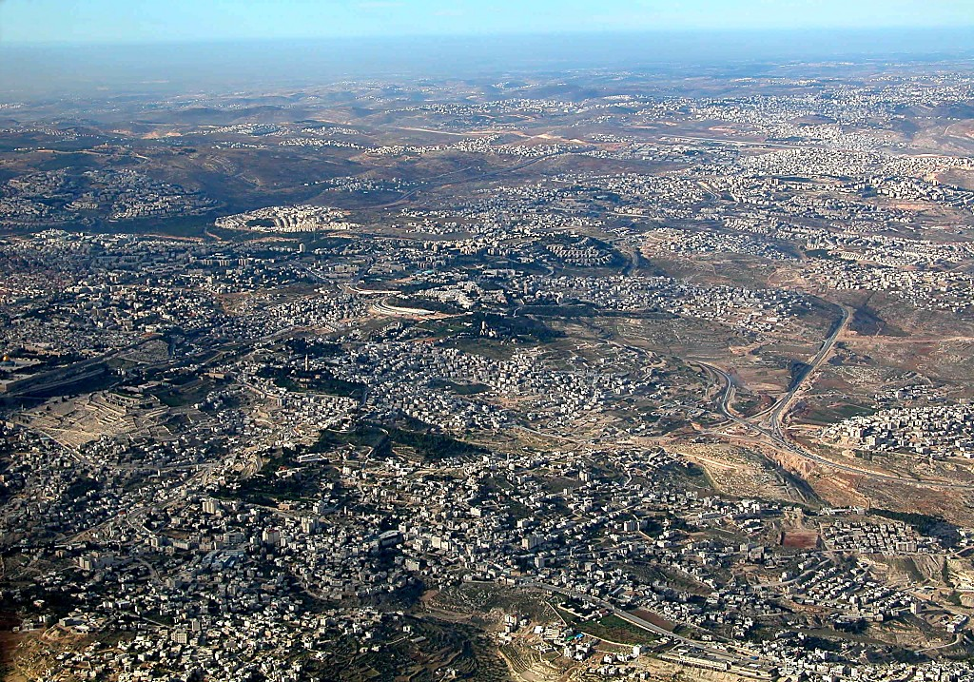
East Jerusalem and Mt of Olives aerial from s
1 Sam. 7:15
Sam. Kerieu 8:4-22
7
Nebi Samwil (Ramah Kheki)
BUT OF THE
MANY JUDGES
OF
ISRAEL...
Samuel: Siedzekesiu mu Capiu; Puo ki mu puo kepenuo ra Jerusalem pesotsatie.
Ruosoki Thiu
THE LAST AND GREATEST,
THE “HINGE CHARACTER,” WAS...
SAMUEL
Samuel kerieu 8:4-19
ANARCHY
Olives kijiithou
Judges
Bethany
350
Dome of the Rock
Jericho nu vo ketuo cha
Chatha leshii, puolha 31-32
11
1
©2006 TBBMI
9.7.03d.
Notes:
Within a very few miles of this region…at either the villages of Ramah or today’s Arabic Nebi Samwil…Samuel was born and lived out his life…within clear view of Jerusalem just a few miles to the south. From this aerial view, it’s easy to see the neighboring closeness of the ancient Biblical sites.
//// In this area, north of Jerusalem, tribal elders from all over Israel converged to meet with Samuel. They begged him to anoint a king for Israel so that their nation could be more like the other kingdoms surrounding Israel at that time.

Slide 13
7
KEBVIIKEBOU
CHAPIMIAKO
350
KEBVIIKEBOU
Chapimiako
“Hie kedimia puo chaya we”
350
“No cha kebau n nei kethozo me?”
350
Chatha leshii, puolha 31-32
12
2
Notes:
“We want a king!” they said. But through Samuel, God tells them that He is their only king, that they need no other. But the people are not satisfied.
//// Following their request, God says through Samuel, in effect, "Are you sure you want to do that?" God then tells Samuel, “All right, anoint a king for them so they will learn the difficult lessons in answering to an earthly sovereign instead of their heavenly authority.”
//// So after some 350 years of apostasy and national rebellion… a time of gross sin and falling away from the worship of the one true God, the era of ANARCHY comes to an end.

Slide 14
Samuel Kerieu 9:17
7
ISRAEL NU CHAPI
13KO DONU...
DEBORAH
GIDEON
Kebviikebou
Kedimiako
THELATHOU MU KEMEYIETHOU,
“KHEPFIIKEBA ZHORIILI” LIRO...
SAMUEL
Chatha leshii, puolha 31-32
13
1
Notes:
…with Samuel serving as that hinge character -- that enormous historic figure who moves Israel forward into the period of its second kind of society…
//// … quite different from ANARCHY. We call it...“ROYALTY.”

Slide 15
7
kKk
“KEDIMIAKO”
14
2
Notes:
Still keeping in mind that geometric shape…
/// that finishes out a circle…called an arc…
//// spelled A…R…C…leading us to the period of Israel’s ROYALTY.

Slide 16
7
Keriekitho nu vo Samuel Kerieu 8:22
PELHOUKESHII
KEBVIIKEBOU
Thepfu mu thenu keriethou
Chapimiako
Kephouma keriethou
350
P
Dieliekevi keriethou
350
Kikru keriethou
KEDIMIAKO
(1000 B.C.)
Kedukhri keriethou
DD
Dziidi/pfhesei
Tsiepfhe
ABRAHAM
(2000 B.C.)
KROTHO 3
P 7 Z J
Puo Kekie
AD
DK
L - S - B
I - I
J - E
12
ANARCHY
KEDIEKECHII
7 = 4 + 3
JOSEF
Chapimiako
MIADIEMIA
THEMIA 4
350
430
350
MOSA
(1500 B.C.)
(500 B.C.)
Tuokepra
Z
S
ZEIKECII
Sinai
M - C - C
Kadesh Barnea
JISU
40
40
KD
5 Diepu
J
JOSHUA
Jericho/Ai
Kijii Kezakewa
15
4
Notes:
And here is the Bible File up to this point.
//// CREATION...
//// ABRAHAM.. JOSEPH...MOSES...JOSHUA...and
//// ANARCHY. Now we move into…
//// ROYALTY...with Samuel as the bridging character during the transition, a man of God enormously influential in the unfolding history of Israel.

Slide 17
PUOTEI HAMESEKIPUO:
ABRAHAM-JOSEF 2000 B.C.
MOSA-JOSHUA 1500 B.C.
KEBVIIKEBOU-KEDIMIAKO 1000 B.C.
16
Notes:
The time line now moves to around 1000 BC…the most glorious time of ancient Israel’s history.

Slide 18
Samuel kerieu 9:1 nu vo Kediko kenieu 25:21
k K k
PELHOUKESHII
ABRAHAM
ABRAHAM
ABRAHAM
JOSEF
ABRAHAM
MOSA
JOSHUA
KEBVIIKEBOU
KEDIMIAKO
KEDIEKECHII
ZEIKETA
JISU
Chatha leshii, puolha 32-37
17
Notes:
And the ROYALTY folder takes its place in the Bible File lineup.
Repeat the entire series aloud as a review: CREATION, ABRAHAM, JOSEPH, MOSES, JOSHUA, ANARCHY, ROYALTY, CAPTIVITY, SILENCE and JESUS.

Slide 19
Mhachii-
Vorketuo
dojii
MS
N(A)
H
KEZEPUO CHIIKECII Israel-e kijii nu kinyi mu kekuo seyie kezhasepuo chiilie!
SG
C
ER
B
J
MN
DS
E
KB
U
MS
PG
RS
Chatha leshii, puolha 32-37
18
1
Notes:
On your map, there is no further path to be traced for now -- because the Israelites are NOW --- FINALLY settled in THE LAND of their inheritance! They will eventually occupy an area from south of the Dead Sea all the way up far north of the Sea of Galilee and from the Mediterranean Sea into the lands east of the Jordan River.
//// At this time…Israel is UNITED, She is to become an international power of enormous wealth and cultural influence among neighboring nations.

Slide 20
7
Samuel kerieu 9:1
ca. 1000 B.C.
KEDIMIAKO
DD
Krothoko donu
Kenieu liro :
KEDIMIAKO
K K K
Chatha leshii, puolha 32-37
19
1
Notes:
ROYALTY is the largest file folder in the Bible File because it is certainly the most complex. But we’ll take it apart…item by item.
//// Timeline again: around 1000 BC.

Slide 21
Samuel kerieu 15:1; Samuel kenieu 2:4; Kediko kerieu 1:39
7
KEDIMIAKO
ca. 1000 B.C.
S - D - S
DD
SAUL
k K k
DAVID
KEDIMIAKO
S - D - S
SOLOMON
Chatha leshii, puolha 32-37
20
4
Notes:
The period of ROYALTY begins as old Samuel anoints SAUL, the first of the three kings of united Israel:
//// SAUL, then…
//// DAVID followed by his son…
//// SOLOMON.
You can remember the order of Israel’s first three kings this way:
//// S-D-S...SAUL, DAVID and SOLOMON.

Slide 22
7
Samuel kerieu 16:13-14
KEDIMIAKO
ca. 1000 B.C.
S - D - S
DD
k K k
Kediu Saul: pechiimeziephikelie miau!
Samuel theja lie pie Saul sie pie
kevor-u : khriesau David,
Bethlehem nu vorkeciiu tsiishii.
KEDIMIAKO
S - D - S
Chatha leshii, puolha 32-37
21
Notes:
Once on the throne, SAUL is an increasingly tormented man. Eventually, God deposes SAUL for his many failures of character and weakness in national leadership. Then once again, the old prophet, Samuel, is called to anoint Saul’s successor as a king for united Israel….and that is to be young David of Bethlehem.

Slide 23
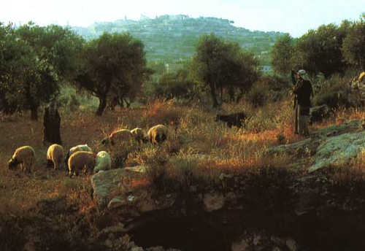
7
Samuel kerieu 16:1
KEDIMIAKO
ca. 1000 B.C.
S - D - S
DD
k K k
KEDIMIAKO
S - D - S
David-a Bethlehem lie nu tekuo pfheba di Samuel puo ngulie.
Chatha leshii, puolha 32-37
22
1
Notes:
Samuel searches throughout the country, finally locating the family of:
//// …Jesse near Bethlehem. Jesse's young shepherd son, DAVID, is identified and anointed by Samuel as Israel’s next and certain king.
In time, King DAVID, the “man after God’s own heart,” succeeds SAUL on the throne of Israel.

Slide 24
7
ca. 1000 B.C.
KEDIMIAKO
S - D - S
David Dietseidiekho
DD
Samuel kenieu 7: 4-16
Seyiedze kerieu 17:3-15
k K k
KEDIMIAKO
S - D - S
Chatha leshii, puolha 32-37
23
1
Notes:
It is to DAVID that the Lord issues the great DAVIDIC COVENANT, His unconditional promise to Israel that she would always have a Son of David to sit upon her throne.
//// Notice that parchment scroll “DC” as it relates to the ROYALTY file folder. The coming Messiah is clearly prefigured…yet 1,000 years in Israel’s future. This is another part of that eternal contract between God and His people that began with Abraham. Add “DC” to your scroll figure

Slide 25
7
DAVID DIETSEIDIEKHO
MHA SE PUPIEKEZHII
Samuel Kenieu 7
¹⁶ Tsiu n kiu siro n kedi kechachie n mhodzii balietuo: n kedibau kechachie balietuo.
KEDIMIAKO
S - D - S
Chatha leshii, puolha 32-37
24
5
Notes:
Here are the central words of that unconditional Davidic contract: 2 Samuel 7, verse 16.
Through Nathan, David's household prophet, God speaks these words: "Your
//// house and your
//// kingdom will endure
//// forever before me; your
//// throne will be established
//// forever.”

Slide 26

Abraham Dietseidiekho
(“Puo Kekie”)
Keriekitho 12: 1-3
KIJII
NUOLHOU
THEJA
Kijii
David
Pulakeshiizho
30:1-10
Samuel Kenieu
7:4 -16
Chatha leshii, puolha 32-37
25
Notes:
So, then…the DAVIDIC COVENANT becomes an amplification of the Seed portion of the ABRAHAMIC COVENANT...the second part of the LAND, the SEED, and the BLESSING formula. This DAVIDIC promise is the SEED portion, the Davidic Covenant. Let’s take a look at David’s Jerusalem.

Slide 27
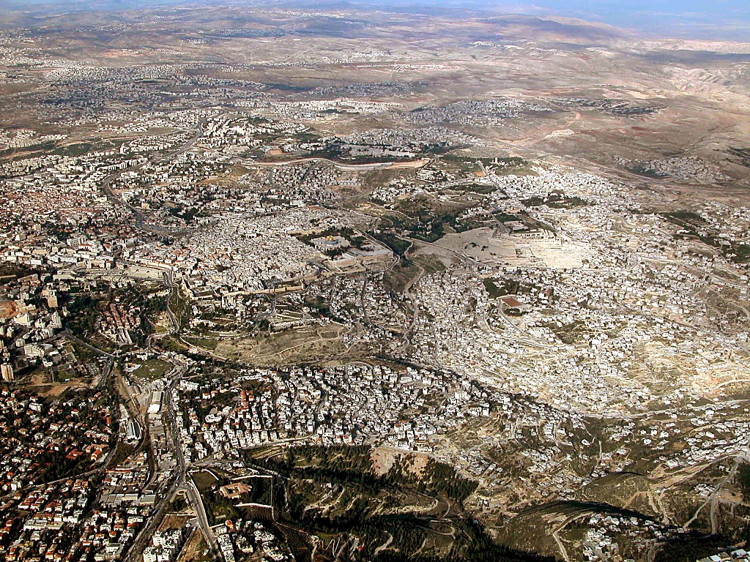
Jerusalem area aerial from south
Pekhro tsatie nu Jerusalem ruosoki thi kevatsa.
26
©2003 TBBMI
7.2.03d.
Notes:
When you fly over Jerusalem today, this is the view as you approach the city from Bethlehem to the south.
//// And right there in the middle of this ancient city lies the focal point of almost every world crisis happening right now and certainly on into the future. It’s the ancient Temple Mount of the Old City.

Slide 28

Old City aerial from north
Samuel Kenieu 24:18-24; Seyiedze Kenieu 3:1
Ruosoki thi-u: Jerusalem melou-u.
9.7.03d.
©2006 TBBMI
27
Notes:
Flying closer, you would see on that Temple Mount the golden-roofed Islamic Dome of the Rock. Also known as Mount Moriah and Mount Zion, this site marks the location of the First Temple of King David and the later Second Temple – built by King Herod the Great -- around which Our Lord ministered to the multitudes. To the far left are the Mount of Olives and the Garden of Gethsemane.

Slide 29
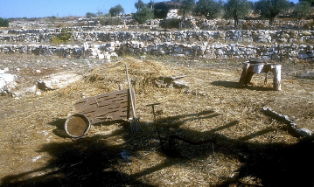


Samuel Kenieu 24:18-24; Seyiedze Kenieu 3:1
Keriekimia ki liekenyiiu
Araunah ki liekenyiiu…
David khriilie…
Ukepenoupfii la ruosoki keriethou chiituo-ii di!
Moriah kijiithou pesotho gei!
28
5
©2006 TBBMI
9.7.03d.
Notes:
And the Temple Mount itself…47 acres of unending international intrigue, strife and dispute…currently controlled by local Moslem authorities. The octagonal Dome of the Rock has occupied this site for 1,400 years! Now…
//// Imagine this place without the Dome of the Rock…3,000 years ago, on the top of Mount Moriah…the same Moriah where Abraham had taken Isaac for sacrifice a thousand years earlier than that.
//// In David’s time, it had become a threshing floor owned by a man named Araunah.
//// David bought that threshing floor from Araunah – similar to this one – on which to build a great worship center…because ever since the time of Moses…
//// …the old tabernacle, housing the sacred Ark of the Covenant, had existed in the fierce winds of the desert. David wanted to see the Furniture of the Lord protected in a fine building…
//// …such as a great Temple to the Lord there atop Mount Moriah.

Slide 30

Kediko Kerieu 5:5
KEDIMIAKO
S - D - S
Kediu David rhiishii.
Derei…puonuo Solomon kiu chiishii!
Chatha leshii, puolha 32-37
29
1
Notes:
So David planned the Temple and brought supplies into town to build it. However, God did not allow David to erect it because he had spilled human blood.
//// It then became an assignment from God that David's son, Solomon, should build the First Temple.

Slide 31

Kediko Kerieu 5:5
KEDIMIAKO
S - D - S
Israel Ruosoki “Keriethou”
chatha leshii, puolha 32-37
30
Notes:
Of course, we have no picture of that Temple. However, this painting shows us its probable grandeur and beauty.

Slide 32
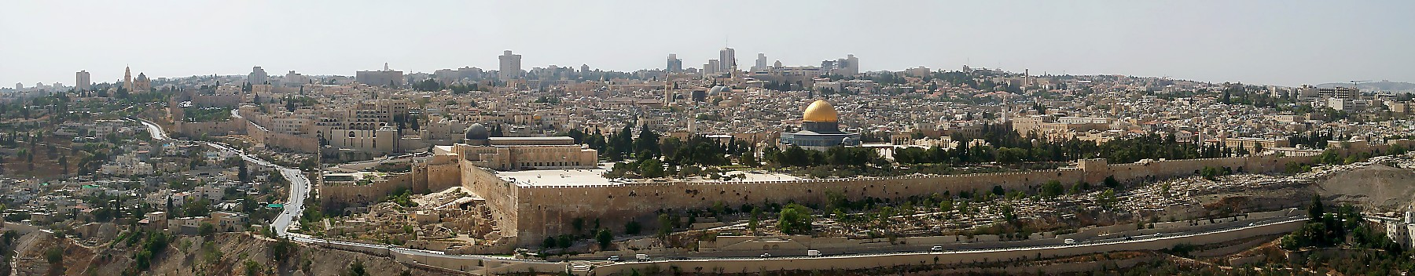
Kediko Kerieu 6:14-38
Tsiedo Jerusalem ruosoki thi-u.
Abraham puo nuou Isak pie se ketheruosuo chiiwatuoii kesie thechii-u
…Moriah kijiithou…Zion kijiithou
Kikemhie di keriekimiako ki hau chiilie ga?
KI CHIIKECII KEKUO MHANYA BAMO!
COMPUTERSKO REI BAMO!
KEDIMIAKO
S - D - S
KICHIIKECII MHAMEZHIIKECII NYA REI BAMO !
Themia Kekuo Riibei se!
Chatha leshii, puolha 32-37
31
6
Notes:
Another idea about the Temple mount gives an appreciation of the thinking and planning processes of those ancient rulers and builders. Here is Jerusalem’s famous Temple Mount as it looks today viewed from atop the Mount of Olives to the east.
//// This place was also the site of ABRAHAM's offering up of ISAAC…on Mount Moriah or Mount Zion…
A question is this…
//// How did the ancient builders accomplish these feats? Searching for that answer gives an interesting insight into this part of Israel's history. How, we ask, were those massive structures built...
//// in a time of no power equipment,
//// no computers,
//// not even a slide rule!
//// There was nothing available but manpower and hard work! How did they even clear the ground for the structure? We have to respect the technology and the brilliance of these ancient people. Here’s an example:

Slide 33
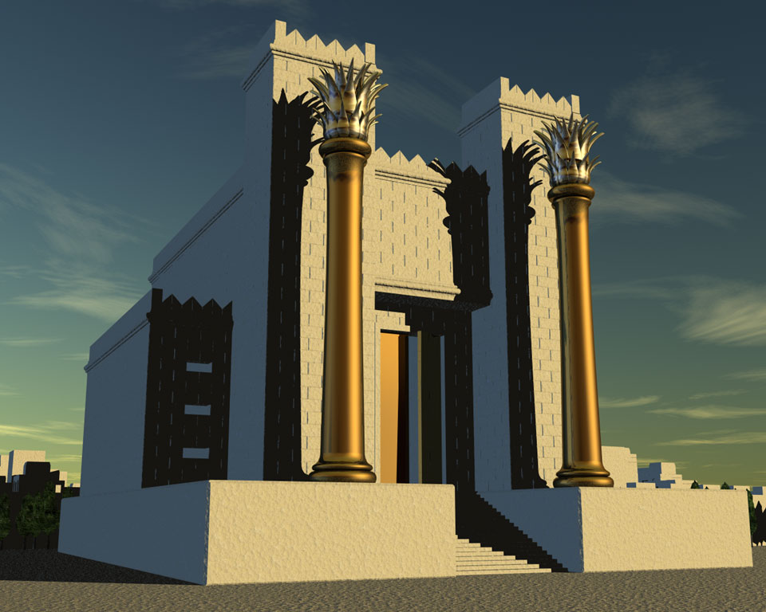
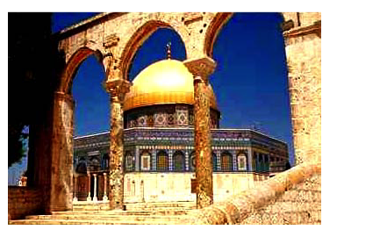
Kediko Kerieu 6:14-38
Tsiedo Jerusalem ruosoki thi-u.
Abraham puonuo-u Isak pie se ketheruosuo chiiwatuoii kesie thechiiu
…Moriah Kijiithou…Zion Kijiithou
Ki ungokecii chiikelie!
Niakratsa /
“Kra keba kitie”
Herod ruosoki “Kenieu”, Jisu teiki.
Solomon chiikeshii ruosoki “Keriethou”
Tsiedo Islamia Dome of the Rock iiyakezhau
Chatha leshii, puolha 32-37
32
6
Notes:
This could be an outline of Mt. Zion...the biblical name for today's Temple Mount.
//// To build these expensive structures, the first step was to clear off and level the top of the mountain ...
//// followed by the construction of a massive pavement with retaining walls of stone and gravel fill.
//// On the left, today, you can see a portion of the retaining wall known today as the Western Wall, or to some, the Wailing Wall.
//// At that site King Solomon built the First Temple to the Lord.
//// It was followed hundreds of years later by the Second Temple familiar in Jesus’ time. Today though, and for the past 1,400 years….
//// the Moslem Dome of the Rock has occupied that same great pavement…since A.D. 685.

Slide 34
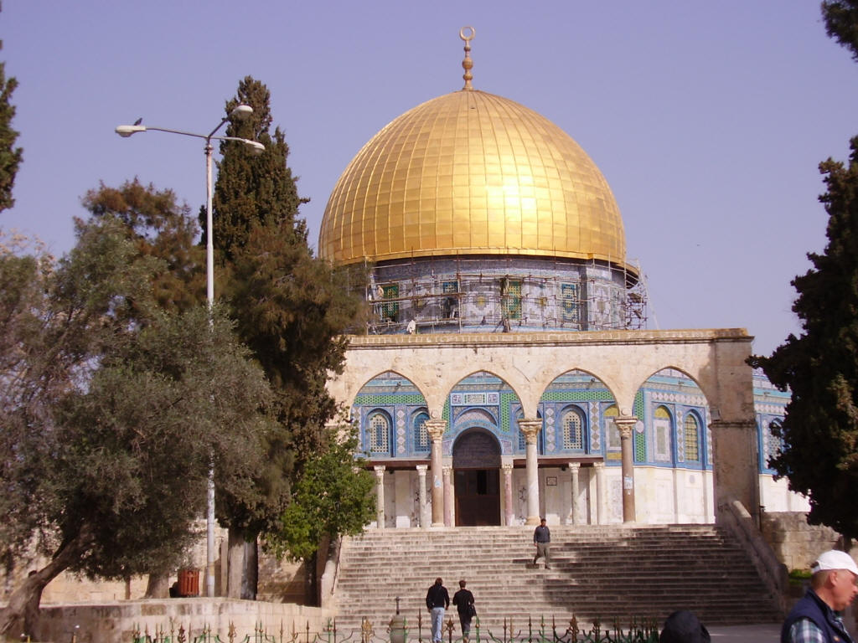
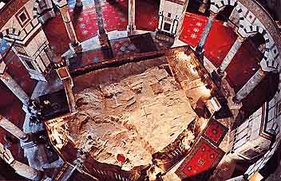
Tsiedo Jerusalem ruosoki thi-u.
Dome of the Rock puonu
Dome of the Rock ruosoki thi-u nu
Chatha leshii, puolha 32-37
32a
1
Notes:
Here is the octagonal shrine as you would approach it from the south, leaving the famed Al Aqsa Mosque, also held by Islam to be one of its most holy sites.
//// Inside the Dome, looking downward, is “The Rock” from which Mohammed is said to have taken his famous midnight ride. The building is covered throughout with hundreds of colorful carpets, its ancient roof supported by a multitude of stone columns.

Slide 35
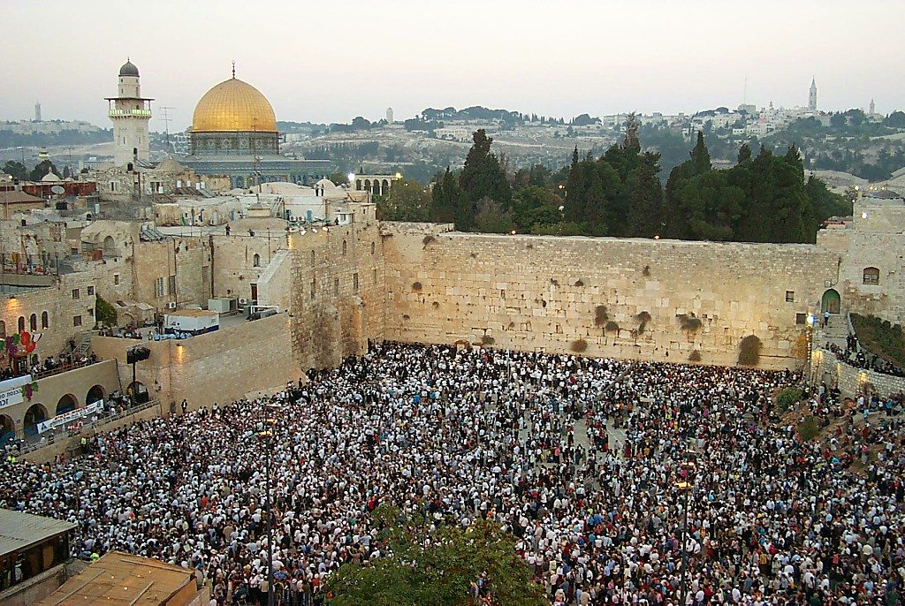
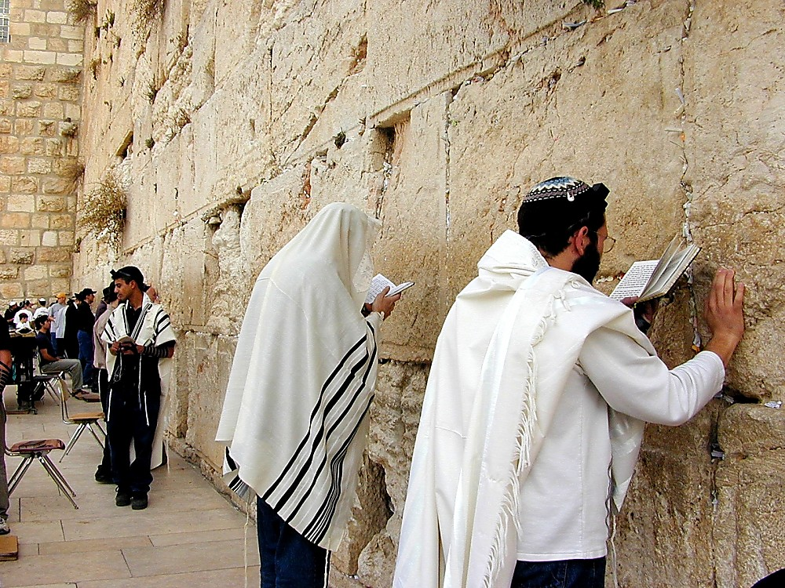
Niakratsa Kitieu, Ruosoki Thiu nu
Kediko Kerieu 6:14-38
Kitieu khekinu kecha chiikeba
KEDIMIAKO
S - D - S
Chatha leshii, puolha 32-37
33
1
Notes:
Directly below the great pavement is the Western Wall today. There are stones here from all the periods of Jerusalem's ancient history.
//// To Jewish people, like these multitudes at prayer, there is no place on the face of the earth more spiritually significant and historically important than right here. On the pavement above the Wall, where the cedars now grow, the great Second Temple stood and Jesus ministered to the multitudes of His day.

Slide 36
Ruosoki Thiu kidepuo rei meyie shi!
Kediko Kerieu 6:14-38; Matt 21:12-17
• Ropfiikitsatie
• Ketholeshiiu kitsatie
• Sorkari zho kitsatie
• Kijii dze phriikecii kitsatie
KEDIMIAKO
S - D - S
• Vorketuo dze kitsatie
Chatha leshii, puolha 32-37
34
6
Notes:
So now…every time you see news footage of Jerusalem, reports of its internal conflicts between Jews and Arabs…just remember the enormous importance of the Temple Mount…the center of it all…
//// The First Temple of King David, the Second Temple built for the Jews by Zerubbabel and expanded by King Herod the Great. Finally, today, the Moslem Dome of the Rock and Al Aqsa Mosque stand on this site. This small acreage was…
//// Israel’s SPIRITUAL center and ritual focus…
//// its THEOLOGICAL and ritual cornerstone…
//// the POLITICAL center of the Jewish universe…
//// the GEOGRAPHICAL center of the Abraham’s inheritance…and
//// for all believers, a key to our understanding of the events of the End Times…that being, the study of Biblical ESCHATOLOGY.

Slide 37

Ruosoki Thiu,Tsiedo Jerusalem nu:
Kijii Melou-u tazo!
Kediko kerieu 6:14-38; Mathi 21:12-17
Chatha leshii, puolha 32-37
35
Notes:
Now we can pull back and view the entire Jerusalem panorama with much greater appreciation of all that has happened there. The Temple Mount of today's Jerusalem continues as the tightly focused center of world concern as the sons of Sarah and the sons of Hagar continue their ancient dispute in the land where it all began!

Slide 38
SOLOMON:PUO KELE KIDEPUO ZHASHI!
7
KEDIMIAKO
ca. 1000 B.C.
S - D - S
DD
Sam Kenieu 7:4-16
Seyiedze Kerieu
17:3-15
k K k
KEDIMIAKO
S - D - S
MHA CAYIEU: PUOMA SOUKETUO .
Chatha leshii, puolha 32-37
36
6
Notes:
Now back to the throne of international Israel in 1000 BC. Main players…
//// S-D-S...SAUL…the first anointed king, and not a very successful one at that.
//// While still living, old Samuel then anoints young DAVID, who follows SAUL to the throne. DAVID is then succeeded on Israel’s throne by one of his many sons,
//// SOLOMON, born through Bathsheba. Under SOLOMON's rule,
//// the great Solomonic Temple is built, and united Israel arises as a national power and a center of enormous wealth and international influence. SOLOMON becomes internationally known for his wisdom and for his ambitious building projects.
//// He had some really big ideas…erected at great cost to his kingdom. But the question finally had to be answered…
//// when the bills came due: who paid for all that? The people…of course…as they always do…through high taxes and/or forced labor.

Slide 39
Solomon Kethachii
Kediko Kerieu 9, 10, 11
7
KEDIMIAKO
ca. 1000 B.C.
S - D - S
Kiu chiikecii!
Khezhanuo Khruokeyiekecii!
Mhajiitoketa!
Terhuorhi riisuokecii!
DD
Sam Kenieu 7:4-16
Seyiedze kerieu
17:3-15
k K k
KEDIMIAKO
S - D - S
chatha leshii, puolha 32-37
37
4
Notes:
Solomon carried out a
//// construction program that was the envy of every king in the region.
//// But, in spite of his great wisdom, SOLOMON pays for it all through the burdens of enormous taxation which,
//// in the end, sent the country into bankruptcy…resulting in huge resentment on the part of the people toward their national government!
//// And if there were not enough problems: he himself fell into idolatry.

Slide 40
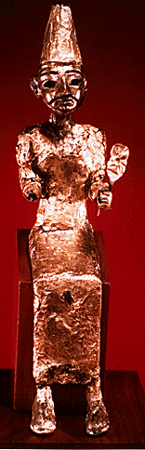
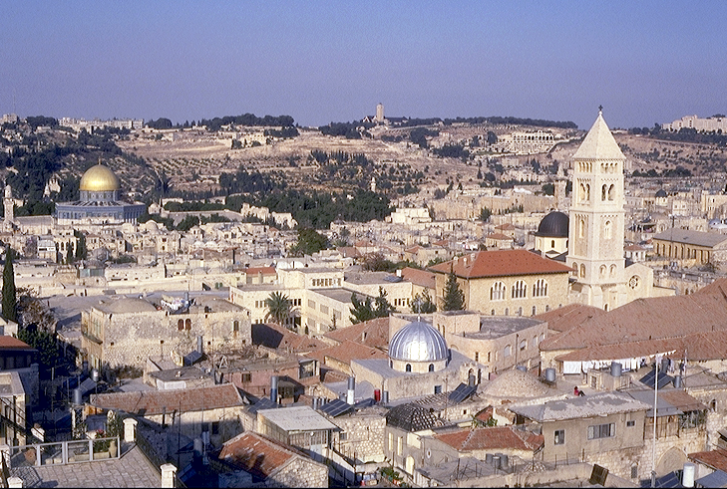
TERHUORHI RiiSUOKECii!
Kediko Kerieu 11:4-13
KEDIMIAKO
Olives Kijiithou-u
ca. 1000 B.C.
S - D - S
DD
Sam Kenieu 7: 4-16
Seyiedze Kerieu 17:3-15
kkk
Ruosoki Thiu
KEDIMIAKO
S - D - S
Chatha leshii, puolha 32-37
38
4
Notes:
Why? Along with Solomon’s many foreign treaties he had also acquired many foreign wives from the country with which he made the treaty. The new wives moved into Jerusalem bringing with them their idolatrous religious practices.
//// On that site of today’s Temple Mount…after SOLOMON had completed the first Temple to the God of Israel – and worshiped there - he later could be seen…
//// …over on The Mount of Olives across the Kidron Valley from his newly built temple…
//// worshipping the pagan gods brought into town by those foreign wives.
//// So…once again…idol worship entered the day to day life of ancient Israel, foreshadowing other great national problems to come

Slide 41
Solomon Sie...
7
Kediko Kerieu 12:25 nu vo 14:31
KEDIMIAKO
ca. 1000 B.C.
S - D - S
<<<< KEZA >>>>
DD
PESO PEKHRO
Sam Kenieu 7:4-16
Seyiedze Kerieu
17:3-15
k K k
ISRAEL JUDAH
10 2
KEDIMIAKO
S - D - S
••• KEZA •••
PESO PEKHRO
Israel
Judah
10 2
Chatha leshii,puolha 32-37
39
3
Notes:
Upon the death of King SOLOMON, there was a vacuum of strong central leadership in Jerusalem.
//// There soon erupted a civil war... followed by a national SPLIT.
//// Quickly, the UNITED kingdom of the Israel of Saul, David, and Solomon...tears apart…becoming the TWO divided kingdoms of the NORTH and the SOUTH...as both descend into increasingly greater sin and spiritual separation from God.
//// TEN tribes join together to become known as the NORTHERN Kingdom, called ISRAEL, while the remaining TWO tribes (BENJAMIN and JUDAH) unite to become the SOUTHERN Kingdom of JUDAH. The Northern Kingdom was the larger…it retained the name ISRAEL.

Slide 42

Kediko Keza ta
Kediko Kerieu 12:25 nu vo 14:31
7
PESOTSA KEDIKO:
ISRAEL
SEYIE 10
SAMARIA
KEDIMIAKO
S - D - S
••• KEZA •••
JERUSALEM
Peso Pekhro
Israel
Judah
SEYIE 2
10 2
PEKHROTSA KEDIKO:
JUDAH
Chatha leshii, puolha 32-37
40
1
Notes:
As a result of the national split…the 10 tribes of the Northern Kingdom, Israel, move their capital north into the region known, even today, as Samaria...
//// …while the two Southern Kingdom tribes, Judah and Benjamin, retain their national capital in Jerusalem.
So...now...the period of ROYALTY continues, but permanently split nationally between the two kingdoms, ISRAEL IN THE NORTH and JUDAH IN THE SOUTH.
Old alliances and ancient tribal relationships come alive as gross sin, idolatry and separation from God and the Law continue to grow and spread through both kingdoms, especially ISRAEL in the North.
Now it's clear to see that the Israel BEFORE the national split was an entirely different nation -- IN CHARACTER AND NATIONAL STYLE -- than that AFTER the split. That is a key idea toward keeping things straight in the Old Testament AFTER King Solomon.

Slide 43
SIEDZEKESIKO
Kediko kerieu 17-22; Isaya nu vo Malaki
7
KEDIMIAKO
ca. 1000 B.C.
S - D - S
<<<< KEZA >>>>
DD
PESO PEKHRO
Sam Kenieu 7: 4-16
Seyiedze Kenieu
17:3-15
k K k
ISRAEL JUDAH
10 2
KEDIMIAKO
S - D - S
••• KEZA •••
Peso Pekhro
Israel
Judah
10 2
SIEDZEKESIKO
Chatha leshii, puolha 32-37
41
Notes:
As the nation further disintegrates across the centuries, the Bible's great Old Testament PROPHETS raise strident voices against the national behavior, both NORTH and SOUTH.

Slide 44
Isaya nu vo Malaki
7
MALAKI
MIKA
KEDIMIAKO
ca. 1000 B.C.
EZEKIEL
S - D - S
ZEFANIA
DANIEL
<<<< KEZA >>>>
ZEKARIA
PESO PEKHRO
JEREMIAH
ISRAEL JUDAH
AMOS
HABAKUK
JOEL
10 2
SIEDZEKESIKO
KEDIMIAKO
S - D - S
HAGAI
••• KEZA •••
PESO PEKHRO
OBADIAH
Israel
Judah
ELISHA
10 2
SIEDZEKESIKO
ELIJAH
ISAYA
HOSEA
NAHUM
JONA…
Chatha leshii, puolha 32-37
42
Notes:
In many writings and in many other forms, the prophets repeatedly call the people back to the righteous ways of their Creator as handed down to MOSES in The Law. At the same time, they write and speak powerfully regarding a future Messiah whose appearance is imminent.

Slide 45
DIETSEIDIEKHO KESAU
7
KEDIMIAKO
ca. 1000 B.C.
S - D - S
<<<< KEZA >>>>
DD
PESO PEKHRO
Sam Kenieu 7: 4-16
Seyiedze Kerieu
17:3-15
k K k
ISRAEL JUDAH
10 2
Dietseidiekho Kesau
KEDIMIAKO
SIEDZEKESIKO
S - D - S
DK
••• KEZA •••
Peso Pekhro
Israel
Judah
10 2
Jer 31: 31-33
SIEDZEKESIKO
Chatha leshii, puolha 32-37
43
Notes:
In the midst of this national depression, however, God speaks through the prophet Jeremiah.
//// The NC in the scroll image represents THE NEW COVENANT -- Jeremiah 31:31-33 -- where God proclaims unconditionally the approaching inauguration of a new program with His people and with all the people of the earth. Add “NC” to the scroll figure on your Study Help.

Slide 46
7
Jeremiah 31
DIETSEIDIEKHO KESAU
³¹ “Harie teisozhako vorzhie,” Jihova sikecii puya, “siikisii a-a Israel
kinuko ze, mu Juda kinuko ze
dietseidiekho kesalietuo.”
Israel
kinuko ze, mu Juda kinuko ze
KEDIMIAKO
S - D - S
••• KEZA •••
Peso Pekhro
Israel
Judah
10 2
SIEDZEKESIKO
MESSIAH PUPIEKEZHIIU!
Chatha leshii, puolha 32-37
44
3
Notes:
Here are the words of the wonderful promise, from the Weeping Prophet, Jeremiah: "The time is coming," declares the Lord, "when I will make…
//// …a new covenant…
//// …with the house of Israel and the house of Judah."
//// In this way, we learn that a Messiah is promised -- one who will deliver all Israel and Judah and all people of the earth -- from the bondage of sin. He is the One who will return them to their original created, sinless relationship to their Creator.

Slide 47
Abraham Dietseidiekho
(“Puo Kekie”)
Keriekitho 12: 1-3
THEJA
KEDIMIAKO
KIJII
THEJA
KIJII
NUOLHOU
S - D - S
NUOLHOU
••• KEZA •••
Peso Pekhro
Israel
Judah
Kijii
David
Kesau
10 2
SIEDZEKESIKO
Pulakeshiizho
30:1-10
Samuel Kenieu
7:4 -16
Jeremiah
31:31-33
Chatha leshii, puolha 32-37
45
5
Notes:
Now we can see…the full amplification of the Abrahamic promise...
the Land, the Seed, and the Blessing statements...all of it represented by
//// the LAND Promise or Covenant…,
//// the DAVIDIC covenant, and, now,
//// the NEW covenant.
So, Jeremiah's announcement specifically amplifies that BLESSING portion of that ABRAHAMIC CONTRACT.

Slide 48
7
Kediko Kerieu 12 nu vo Kediko Kenieu 24
KEDIMIAKO
ca. 1000 B.C.
S - D - S
DD
<<<< KEZA >>>>
PESO PEKHRO
Sam Kenieu 7:4-16
Seyiedze Kerieu
17:3-15
k K k
ISRAEL JUDAH
10 2
KEDIMIAKO
SIEDZEKESIKO
DK
S - D - S
••• KEZA•••
Peso Pekhro
20-J 20-R
Israel
Judah
10 2
Pekhro: Rehoboam
SIEDZEKESIKO
Peso: Jeroboam
20-J 20-R
KEDI KEVI BAMO
KEDI KEVI HOYO BA
Chatha leshii, puolha 32-37
46
2
Notes:
In each of the two kingdoms,
//// …20 kings reigned in the Northern Kingdom and 20 kings in the Southern…beginning with JEROBOAM in the NORTH…remember it by 20-J….and REHOBOAM in the SOUTH…20-R. You can remember that order this way: North above South; J before R.
//// The NORTHERN KINGDOM OF ISRAEL is, by far, the more wicked, rebellious and idolatrous of the two. There were NO GOOD KINGS IN THE NORTHERN KINGDOM. However, in the South, there were some, though very few, good kings.

Slide 49
7
Kediko Kenieu 17:6
KEDIMIAKO
ca. 1000 B.C.
S - D - S
DD
<<<< KEZA >>>>
PESO PEKHRO
Sam Kenieu7: 4-16
Seyiedze Kerieu
17:3-15
k K k
ISRAEL JUDAH
10 2
KEDIMIAKO
SIEDZEKESIKO
DK
S - D - S
••• KEZA •••
Peso Pekhro
20-J 20-R
Israel
Judah
10 2
200
Jer 31: 31-33
SIEDZEKESIKO
20-J 20-R
200
ASSYRIA
Assyria
Chatha leshii, puolha 32-37
47
Notes:
Israel, the NORTHERN KINGDOM, existed for about 200 years. Then from out of the far northeast, God sends his judgment in the
form of the dreaded ASSYRIANS who…

Slide 50
Kediko Kenieu 17:6
Mhachii-
Vorketuo
dojii
MS
N(A)
H
SG
C
ER
B
J
MN
KEDIMIAKO
DS
S - D - S
••• KEZA •••
E
Peso Pekhro
PESOTSA KEDIKO:
ISRAEL (722 B.C.)
Israel
Judah
KB
U
10 2
SIEDZEKESIKO
20-J 20-R
200
Assyria
MS
PG
Judamiako ta kezakeziketa!
RS
Chatha leshii, puolha 32-37
48
1
Notes:
…sweep down to take the NORTHERN KINGDOM away.
The people are dispersed -- absorbed by the Assyrians and other cultures of that day. This becomes known as the great Diaspora, or Dispersion, of the Jews.
//// The year is 722 BC. In all of our study, there are only two specific dates that are helpful to remember. The capture of the NORTHERN KINGDOM, 722 BC, is one of them. Never again do we hear of the NORTHERN KINGDOM as a united people. Through the following centuries they are gradually dispersed throughout the world.

Slide 51
Mhachii-
vorketuo
dojii
MS
Derei… PEKHROTSA Kediko liro?
N(A)
H
SG
C
ER
B
J
MN
KEDIMIAKO
DS
S - D - S
BABYLON-a ASSYRIA PENYIIWATA!
••• KEZA •••
E
Peso Pekhro
Israel
Judah
KB
U
10 2
SIEDZEKESIKO
20-J 20-R
200
Assyria
MS
PG
RS
Chatha leshii, puolha 32-37
49
2
Notes:
However…The SOUTHERN KINGDOM OF JUDAH experiences quite a different kind of judgment.
//// By this time, the Babylonians defeat the Assyrians. Then…
//// The Babylonian King Nebuchadnezzar now turns his attention toward Judah, that remaining Southern kingdom.

Slide 52
Kediko Kenieu 25
7
KEDIMIAKO
ca. 1000 B.C.
S - D - S
DD
<<<< KESA >>>>
PESO PEKHRO
Sam Kenieu 7:4-16
Seyiedze Kerieu
17:3-15
k K k
ISRAEL JUDAH
10 2
DK
KEDIMIAKO
SIEDZEKESIKO
S - D - S
••• KEZA •••
Peso Pekhro
20-J 20-R
Israel
Judah
Jer 31: 31-33
10 2
200
350
SIEDZEKESIKO
20-J 20-R
200
350
ASSYRIA
BABILON
Assyria
Babilon
Chatha leshii, puolha 32-37
50
Notes:
IN JUDAH…where there were a few good kings…that kingdom lasts for about 150 years longer -- or for a total of 350 years after the national split.

Slide 53
Kediko Kenieu 25: 1-21
Mhachii-
vorketuo
dojii
MS
N(A)
H
SG
C
ER
B
J
MN
KEDIMIAKO
DS
S - D - S
••• KEZA •••
E
Peso Pekhro
PEKHROTSA KEDIKO:
JUDAH (586 B.C).
BABILONMIA CHAZOU VO LHOUTUOKETA
Israel
Judah
KB
U
10 2
SIEDZEKESIKO
20-J 20-R
200
350
Assyria
Babilon
MS
PG
RS
Chatha leshii, puolha 32-37
51
2
Notes:
Then, in the terrible onslaught of 586 BC, JUDAH, herself,
//// faces the invasion of the BABYLONIANS under King Nebuchadnezzar. All of Jerusalem -- including SOLOMON's great Temple -- is completely destroyed by the Babylonians. This is that second and important specific date to remember…586 B.C.
//// The SOUTHERN KINGDOM OF JUDAH is carried away into the famous Babylonian CAPTIVITY, sometimes called the EXILE.

Slide 54
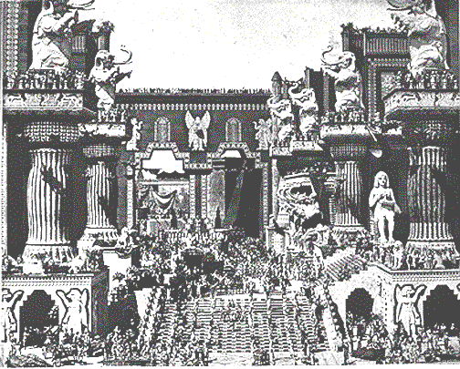
Kediko Kenieu 25: 1-21
KEDIMIAKO
S - D - S
••• KEZA •••
Peso Pekhro
Israel
Judah
10 2
SIEDZEKESIKO
20-J 20-R
200
350
Babilon
Assyria
Babilonmia riina keriethoki
Miarhi hau miarhi petakecii “Intolerance” nunu separ.
Chatha leshii, puolha 32-37
52
Notes:
…into a distant city and country where two of Judah's most famous prophets, Daniel and Ezekiel, will speak and write their messages of hope in foretelling the glorious Messiah. In this artist's conception, you can sense the flavor of Babylon…that enormous capital of the ancient world.

Slide 55
Genesis nu vo Nehemiah
7
PELHOUKESHII
KEBVIIKEBOU
Thenu thepfu kerietho nie
Chapimiako
Kephouma Keriethou
350
P
Dieliekevi Keriethou
350
Kikru Keriethou
(1000 B.C.)
Kedukhri Keriethou
KEDIMIAKO
(1000 B.C.)
Dziidei/Pfhesei
S - D - S
DD
Tsiepfhe
••• KEZA •••
KROTHO 3
Peso Pekhro
(2000 B.C.)
ABRAHAM
(2000 B.C.)
Israel
Judah
Puo KEKIE
10 2
DK
P 7 Z J
AD
SIEDZEKESIKO
L - S - B
20-J 20-R
I - I
200 350
J - E
Assyria Babilon
12
JOSEF
KEDIEKECHII
7 = 4 + 3
KEDIMIAKO
Miadiemia
S - D - S
430
••• KEZA •••
THEMIA 4
Peso Pekhro
(1500 B.C.)
Israel
Judah
MOSA
(1500 B.C.)
(500 B.C.)
10 2
Tuokepra
Z
S
ZEIKECII
SIEDZEKESIKP
Sinai
20-J 20-R
M - C - C
200
350
Kadesh Barnea
JISU
Assyria
Babilon
40
40
KD
Diekepu 5
J
JOSHUA
Jericho/Ai
Kijii Kezakewa
53
Notes:
So the ROYALTY period and its folder in THE BIBLE FILE come to an end.
As Israel and Judah face the judgment of dispersion for the one, and temporary exile for the other, history moves us from ROYALTY …

Slide 56
7
K
k k
“KEDIEKECHII”
Chatha leshii, puolha 37-38
54
1
Notes:
...into the last of the three kinds of Biblical societies, CAPTIVITY.
//// Remember the geometric memory tool of A-R-C

Slide 57
Kediko Kenieu 25:21 nu vo Ezra 1:3
K K K
PELHOUKESHII
ABRAHAM
ABRAHAM
ABRAHAM
JOSEF
ABRAHAM
MOSA
JOSHUA
KEBVIIKEBOU
KEDIMIAKO
KEDIEKECHII
ZIKECII
JISU
Chatha leshii, puolha 37-38
©2006 TBBMI
55
Notes:
….we come to the eighth Bible File folder, the one called... “CAPTIVITY”

Slide 58
PUOTEI HAMESEKIPUO:
ABRAHAM-JOSEF 2000 B.C.
MOSA-JOSHUA 1500 B.C.
KEBVIIKEBOU-KEDIMIAKO 1000 B.C.
KEDIEKECHII - ZEIKECII 500 B.C.
56
Notes:
Its time-line...moving now 500 years closer to the time of the Savior... about 500 BC

Slide 59
JUDAH Pekawamo!
Isaya 9:6-7
Mhachii-
vorketuo
dojii
Puothela nu…
MS
N(A)
H
SG
C
ER
B
J
MN
DS
E
KI-II DI GA?
KB
U
MS
Kekreilamonyii:Judah seyieu geinu MESSAIH vorketuo pupiezhiiwaketa la.
PG
RS
Cahtha leshii, puolha 37-38
57
8

Slide 60
Kediko Kenieu 25:21
7
KEDIEKECHII
Krotho 3ko
donu
Seu liro:
KEDIEKECHII
K K K
Chatha leshii, puolha 37-38
58
Notes:
And here is CAPTIVITY's file folder from the Bible File sequence ready for the four items important to this period in the life of ancient Judah.

Slide 61

Daniel 1
Babilon riina keriethoki
KEDIEKECHII
Eufrat kerii
Babilon nu Hanging Tezie
Chatha leshii, puolha 37-38
59
Notes:
Babylon -- that enormous Oriental metropolis next to the Euphrates River -- is the site of JUDAH's 70 years of captivity, shown here in an artist re-creation of the possible appearance of that incredible city. The famed Hanging Gardens of Babylon -- visible on the right -- were among the Seven Wonders of that Ancient World.

Slide 62
7
KEDIEKECHII
MHACHII KETUO CHAKO
Chatha leshii, puolha 37-38
60
Notes:
Remember, also, that Babylon -- located on your map many miles upstream from the Persian Gulf – was very near the heart of today's troubled Persian Gulf region in the Middle East.

Slide 63
Jer. 29:10; Ezra 3:8; Neh. 2:5-6
7
KEDIEKECHII
TEICIE 70
CHA 3
K K K
KEDIEKECHII
Teicie 70
Cha 3
“JUDAMIA”
“JUDAMIA”
“SINAGOG”
“SINAGOG”
Chatha leshii, puolha 37-38
61
3
Notes:
After the 70 years of Judah’s exile, the Babylonian rulers allowed the captives from the SOUTHERN KINGDOM OF JUDAH to return to Jerusalem, and to rebuild their city, its walls and their Temple.
//// And it was during this time of the Babylonian Exile that the people of JUDAH came to be called Jews -- from the tribal name of JUDAH.
//// The worldwide Jewish tradition of the synagogue was also born in Babylon during Judah’s Captivity or Exile.
//// The Return to The Land took place in 3 massive treks. These were difficult trips on foot from Babylon back to the Land.

Slide 64
7
LAKEVOR CHA SEKO
K K K
KEDIEKECHII
Teicie70
cha 3
MHACHII KETUO CHAKO
Chatha leshii, puolha 37-38
62
Notes:
The returning Jews moved up along the Fertile Crescent route probably near the Euphrates River....then finally turning away southward toward the Land of Israel. That route was absolutely necessary. Otherwise the returnees would be unable to survive the harsh desert conditions that lay directly westward between Babylon and Jerusalem.

Slide 65
Ezra 1 nu vo 2
7
KEDIEKECHII
TEICIE 70
CHA 3
K K K
Teicie 100 / 50,000
KEDIEKECHII
Teicie 70
Cha 3
Teicie 100 / 50,000
Chatha leshii, puolha 37-38
63
Notes:
The THREE TREKS back to the land lasted about 100 years. During that time some 50,000 people returned.

Slide 66
Ezra 1:4
50,000 LAKEVOR!
DEREI MIAKEKRA LA BA DI KEVORKO MEZASHII.
KEDIEKECHII
Teicie 70
Cha 3
Teicie 100 / 50,000
Chatha leshii, puolha 7-38
64
1
Notes:
Even though some 50,000 Jews left Babylon to return to the Land of their Promise…
//// …many Jews back in Babylon had been successful in business, living in their own houses. Those Jews were largely responsible for financing the trips back, and for the work of reconstruction by the returnees.

Slide 67
Jer. 29; Ezra 3; Neh. 2
7
ZERUBBABEL
KEDIEKECHII
EZRA
TEICIE 70
CHA 3
K K K
TEICIE 100 / 50,000
Z - E - N
KEDIEKECHII
NEHEMIAH
Teicie 70
Cha 3
TEICIE 100 / 50,000
Z - E - N
Chatha leshii, puolha 37-38
65
4
Notes:
During those difficult journeys back to Israel from Babylon, three famous names move into national leadership.
//// Remember those names by recalling the word Z-E-N...these three great men, sometimes called diplomat-priests, in order, were
//// ZERUBBABEL...
//// EZRA... and
//// NEHEMIAH.

Slide 68
Neh. 3
7
ZERUBBABEL…ruosoki chiiketuola lakevor.
ZERUBBABEL
MIADIEMIA
EZRA…Ukepenuopfii die pethaketuola lakevor.
EZRA
TEICIE 70
CHA 3
Z-E-N
Teicie 100 / 50,000
Z - E - N
KEDIEKECHII
Zievo kezhamia se
NEHEMIAH
Teicie 70
NEHEMIAH…lavor di Ketholeshii Keweu nu chatha kemeyie se puo chiilalie mu riinau careko mu sozhako chiikesalalie.
Cha 3
Teicie100 / 50,000
Z - E - N
Chatha leshii, puolha 37-38
66
3
Notes:
ZERUBBABEL is remembered because of his crucial role in beginning the rebuilding of the actual Temple structure, small though it was…
//// EZRA...the great priest who went to Jerusalem to teach the law of the Lord to the returned people...
//// While NEHEMIAH, that famed Old Testament administrator and leader, returned to rebuild the city’s gates and walls. In an astonishingly short time, he and his men rebuilt Jerusalem’s crucial defenses.
//// These three great men…Z-E-N….Zerubbabel, Ezra and Nehemiah…the diplomat-priests…were at the center of Judah’s return, carefully guiding the development of an exiled nation now back in its homeland.

Slide 69
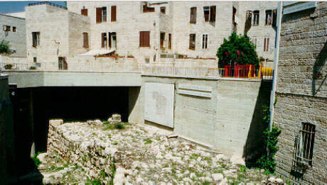
Neh. 3:8
Jerusalem:Nehemiah Kitie (tsiepfhe)
KEDIEKECHII
Teicie 70
Cha 3
Teicie 100 / 50,000
Z - E - N
Chatha leshii, puolha 37-38
67
Notes:
In fact, biblical scholars are quite certain that these archeological digs, in the heart of Jerusalem, are, indeed, the remains of those walls rebuilt by Nehemiah and his Jewish construction crews.

Slide 70
Z-E-N
Jer. 29:10; Ezra 3:8; Neh. 2:5-6
7
ZERUBBABEL
ZERUBBABEL…ruosoki chiiketuo
la lakevor.
MIADIEMIA
TEICIE 70
Zievo Kezhamia Se
EZRA…Ukepenuopfii die pethaketuo la lakevor.
EZRA
CHA 3
Teicie 100 / 50,000
Z-E-N
Z - E - N
KEDIEKECHII
NEHEMIAH
Teicie 70
NEHEMIAH…lavor di Ketholeshii Keweu nu chatha kemeyie se puo chiilalie mu riinau careko mu sozhako chiikesalashii.
Cha 3
Teicie 100 / 50,000
Z - E - N
Chatha leshii, puolha 37-38
68
3
Notes:
At the end of the Old Testament…
//// With the Northern Kingdom…ISRAEL…now dispersed
//// and the Southern Kingdom…JUDAH…back in the Land…
the CAPTIVITY period of The Bible File comes to an end.
And across the entire panorama of Old Testament Scripture…from Genesis to Malachi…
//// Messiah is promised IN THE FULLNESS OF TIME!

Slide 71
Keriekitho nu vo Esther
7
PELHOUKESHII
KEBVIIKEBOU
Thepfii Thenu kerietho nie
Chapimiako
Kephouma keriethou
350
C
Dieliekevi keriethou
350
Kikru keriethou
(1000 B.C.)
Kedukhri keriethou
KEDIMIAKO
(1000 B.C.)
Dziidei/Pfhesei
S - D - S
DD
Tsiepfhe
••• KEZA •••
Peso Pekhro
(2000 B.C.)
ABRAHAM
(2000 B.C.)
Israel
Judah
Puo Kekie
10 2
DK
P 7 Z J
AD
SIEDZEKESIKO
L - S - B
20-J 20-R
I - I
KROTHO 3
J - E
200 350
Assyria Babilon
12
KEDIEKECHII
7 = 4 + 3
JOSEF
Teicie 70
KEDIEKECHII
Miadiemia
Cha 3
Teicie 70
430
Teicie 100 / 50,000
THEMIA 4
Cha 3
Z - E - N
100 Years / 50,000
(1500 B.C.)
Teicie 100 / 50,000
MOSA
(1500 B.C.)
(500 B.C.)
Z - E - N
Tuokepra
Z
S
ZEIKECII
Sinai
M - C - C
Kadesh Barnea
JISU
40
40
KD
Diekepu 5
J
JOSHUA
Jericho/Ai
Kijii Kezakewa
69
1
Notes:
At the eighth file folder of CAPTIVITY in the series of ten BIBLE FILE FOLDERS we are at the end of the Old Testament…also bringing us to the end of the 3 great societies.…ANARCHY ...ROYALTY...and CAPTIVITY…
//// …and showing us in their complete presentations THE FOUR OLD TESTAMENT CONVENANT PROMISES…the ABRAHAMIC…the LAND…the DAVIDIC…and THE NEW COVENANTS. Moving on now to SILENCE.

Slide 72


Ketholeshiida…Dietherieko • BibleStudyDownloads.org
Get this presentation for free!
Notes:
The Bible…Basically (bb)

Slide 73
70
9.7.03d.

